Slide 1
Page 1
Page 1
BEHRUZ
TURSUNBOYEV
HIGH SCHOOL STUDENT
behruztursunboyev190@gmail.com
+998998170500

Slide 2
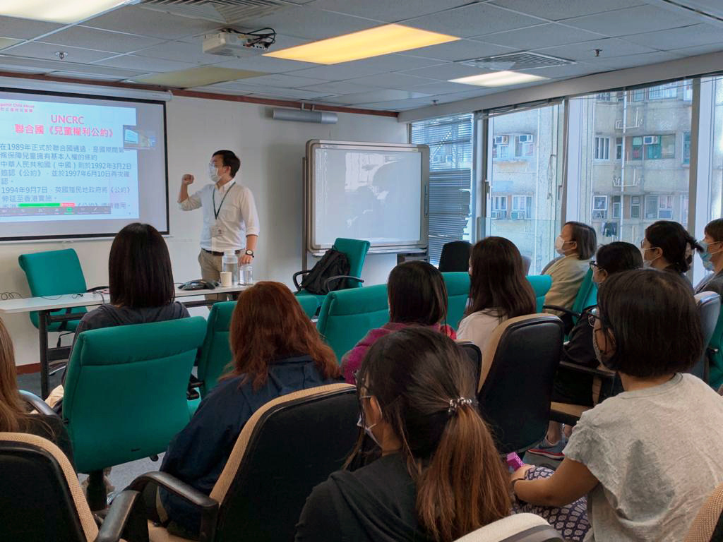
Page 3
Page 3
EDUC-ATION
Buka district specialised school
9 shukrona street
2022-now

Slide 3
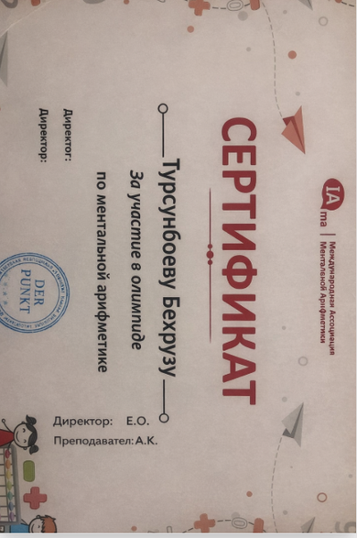
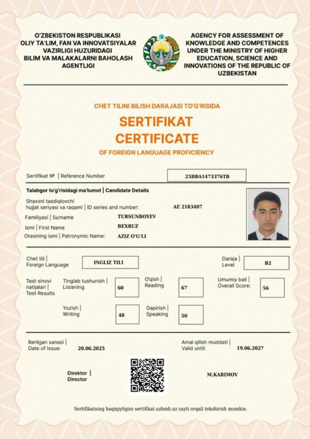
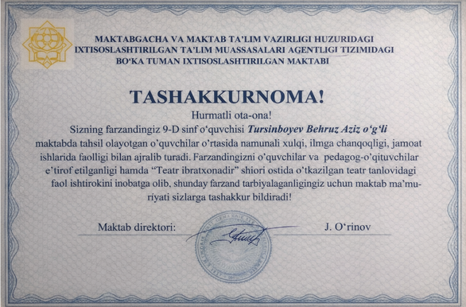
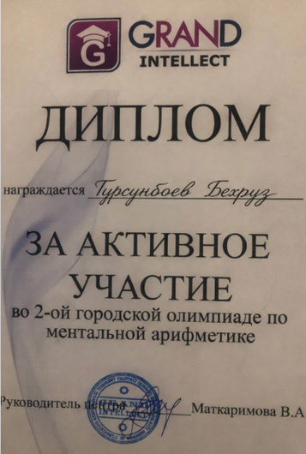
Achievements
Page 2
Language certificates:
IELTS 5.5
CEFR B2
Theatre:
Second place-“Teatr ibratxonadir” event
arithmetic
Second place-”grand intellect” competition
“International mental arithmetic olimpiad”

Slide 4
Page 4
Page 4
Basic Programming & IT Skills
Problem Solving & Logical Thinking
Business & Strategic Thinking
Communication & Teamwork
Leadership & Responsibility
Time Management & dicipline
Creativity & Innovation
Analytical Thinking
SKILLS

Slide 5
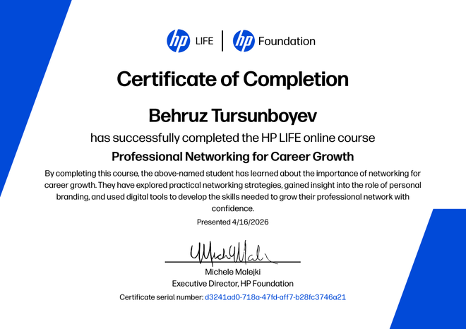
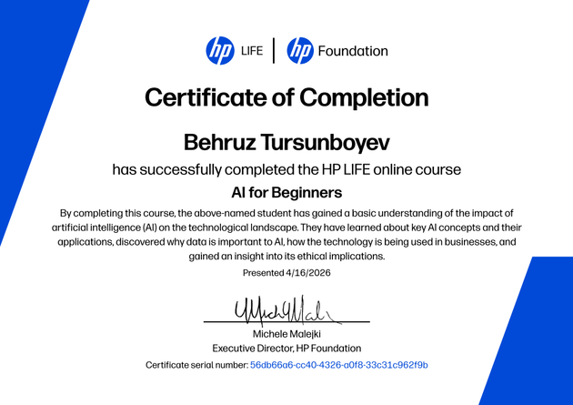
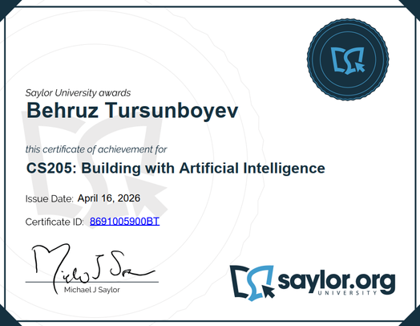
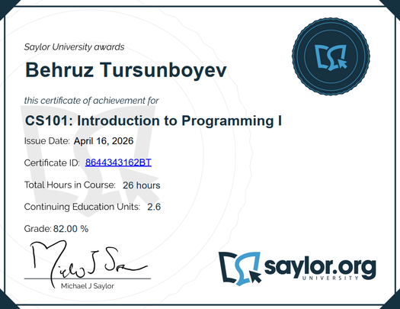
Page 5
CERTIFICATES
Page 5
HP cartificate: AI for beginners
Saylor academy: Introduction to programming
HP certificate: Professional career for personal growth
Saylor academy: Building with artificial intelligence
Clear Goals
Creative Content
Engagement and Interaction

Slide 6
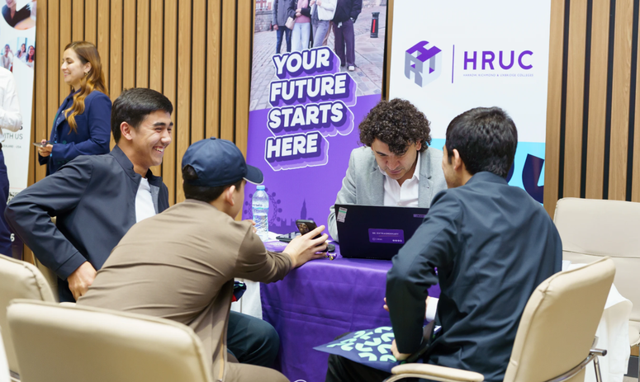
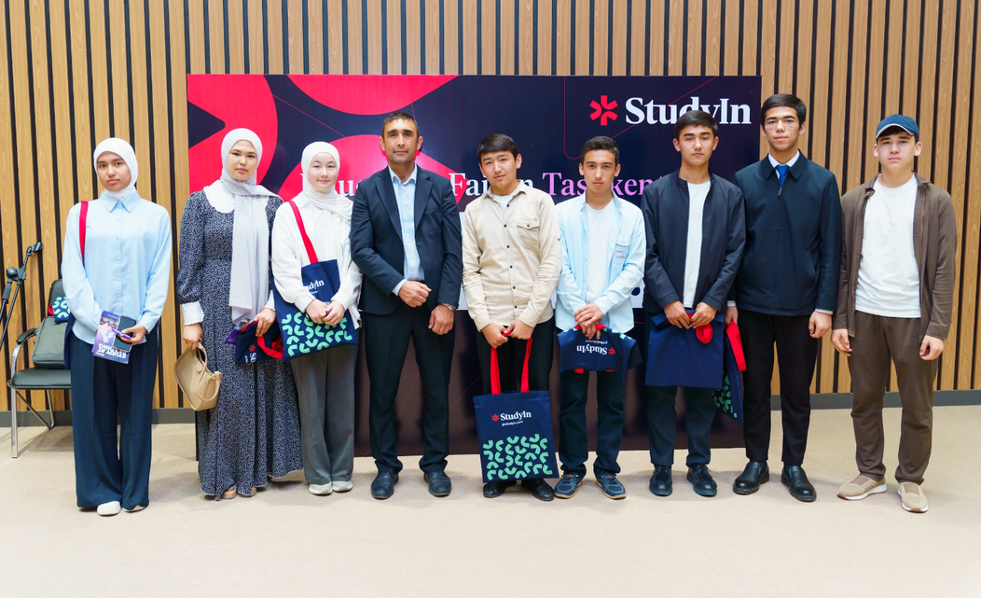
Page 6
Experience
Audience engagement and growth are essential for building a loyal and active following on social media. Engagement refers to the interaction between your audience and your content (likes, comments, shares, clicks), while growth focuses on increasing your follower base and extending your reach. A strategy for both involves creating meaningful connections, fostering conversations, and providing value to your audience.
Page 6
Here’s a step by step guide to boost audience engagement and growth
Understand Your Audience
Post High-Quality and Relevant Content
Be Consistent with Posting
Encourage Interaction
Engage with Your Audience Actively
Collaborate with Influencers and Partners

